Slide 1
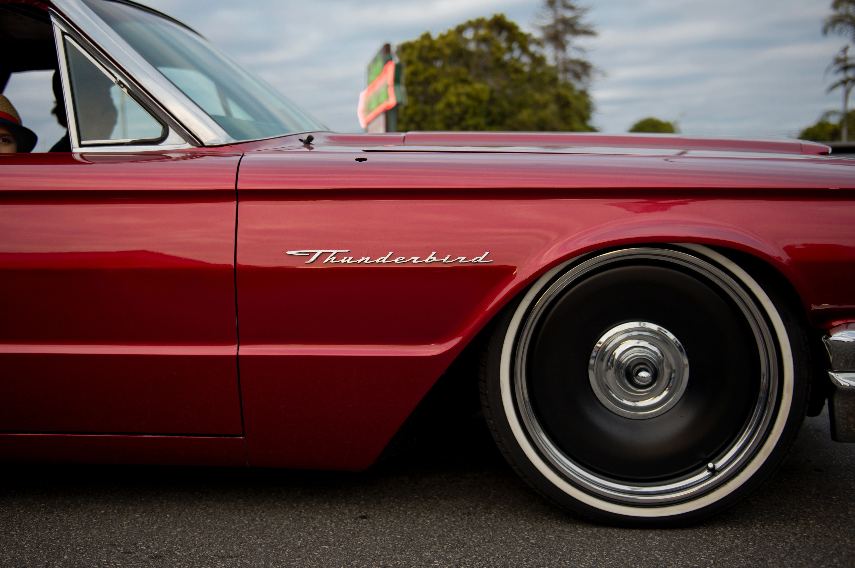
PartsTech AI
Oscar Chávez
Mathilde Vankelegom
Patrick Moss

Slide 2
Objectives
Facilitate the look up of automotive parts.
Create a natural interface, such as a chat.
Increase the conversion rate through a payment gateway
Avoid entry barriers like downloading an app.

Slide 3
Goals
Integrate the PartsTech API
Create a chat UI on top of the API.
Use NLP to differentiate entities
Create a smart chatbot.
Allow clients to find or quote automotive parts
Track new and potential clients.

Slide 4





PartsTech AI
Distribution

Slide 5
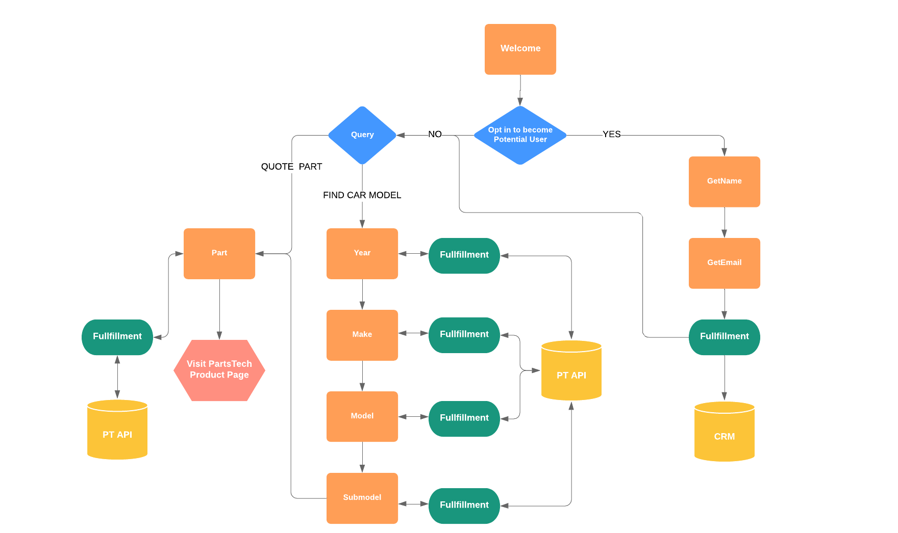
Flow

Slide 6






Architecture
Presentation Layer
Business Layer
Data Layer
Telegram
Dialogflow
Agent
Cloud Functions
RESTful API
Phone Interface

Slide 7
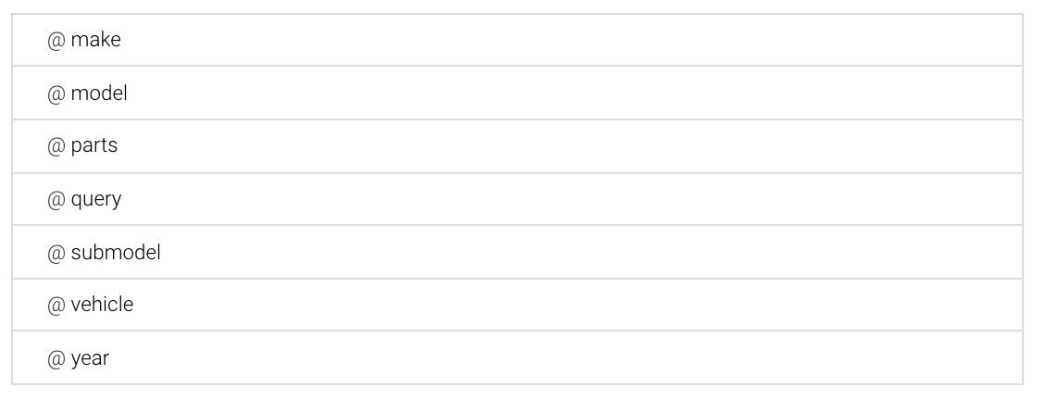
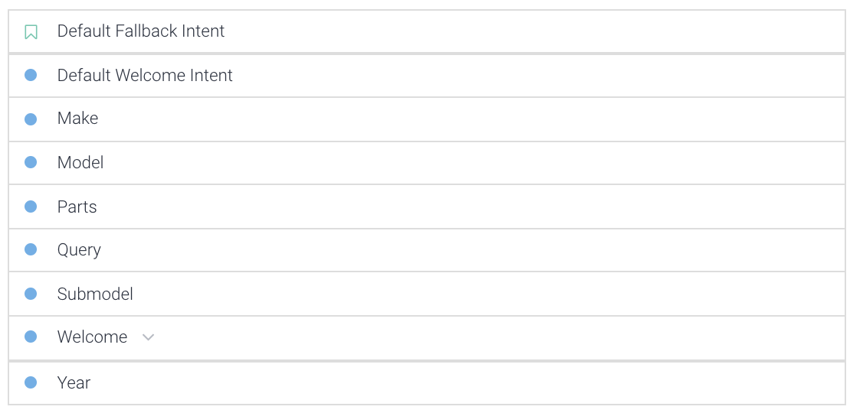
NLP - Intents & Entities

Slide 8
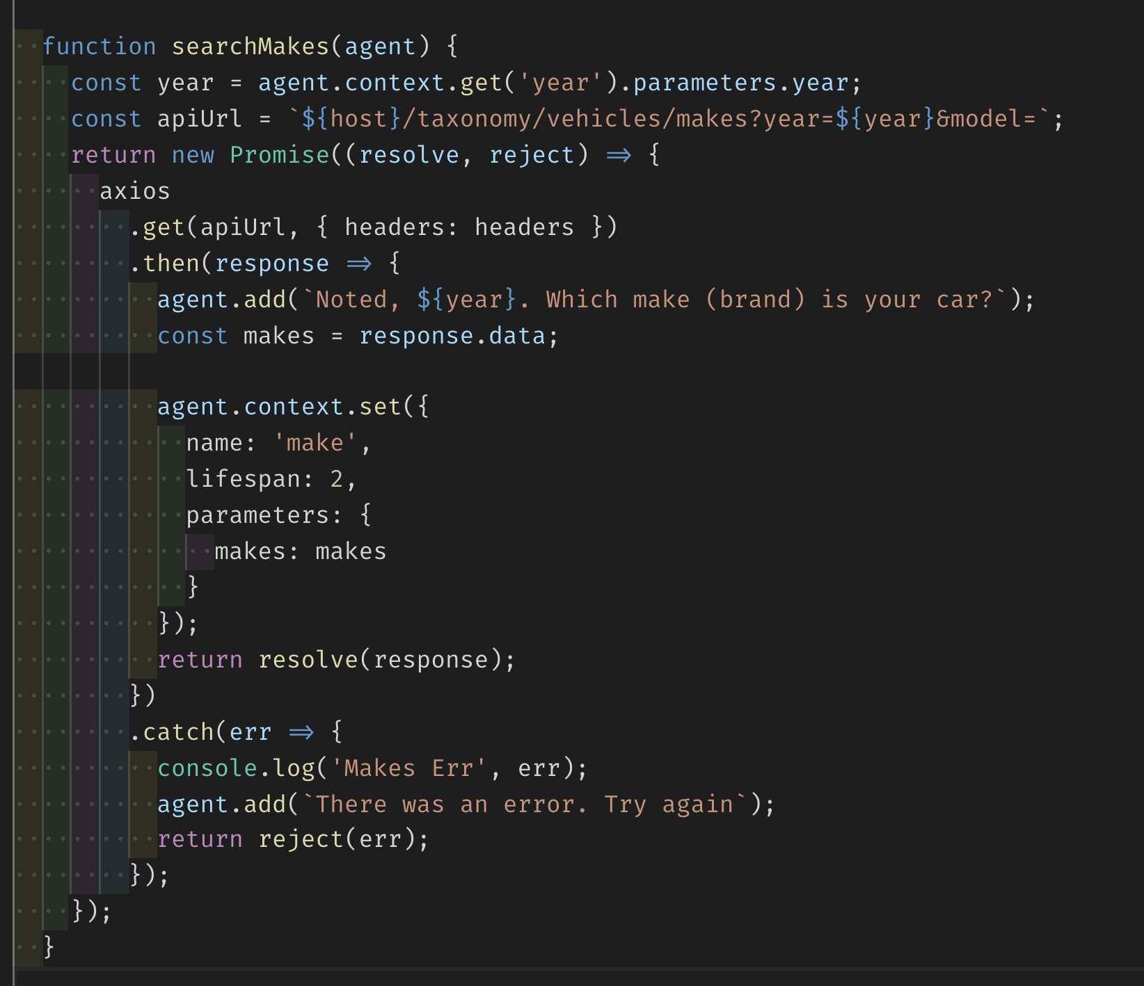
Cloud Functions

Slide 9
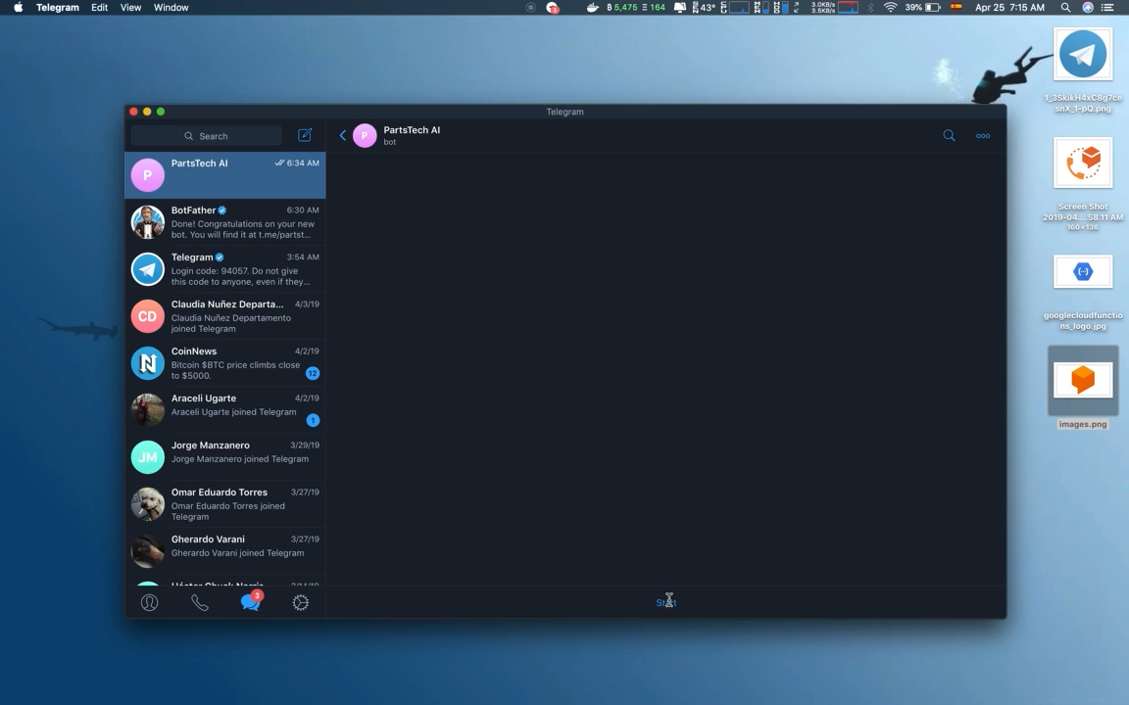
Demo

Slide 10
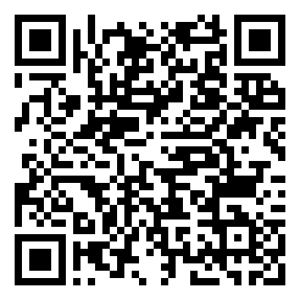
Links
https://bot.dialogflow.com/507aa16c-9eaa-42cb-a341-aed4527cd3a7
https://t.me/partstechai_bot
+1 323-364-5637

Slide 11
Github
https://github.com/oschvr/partstechai

